Slide 1
DBMS
UNIT I | INTRODUCTION ER MODELING | No of Hrs: 7
Basic concepts – Databases and database users – Database system concepts and architecture – data modeling using Entity Relationship model. Relational Model.
UNIT 1

Slide 2
DBMS
Readings:
  R.Ramakrishna & J Gehrke
  Other readings:
  Silberschatz, Korth & Sudarshan
  C.J.Date
  Elmasri Nawathe

Slide 3
DBMS: Introduction
Overview of Database Systems
Advantages of DBMS over File systems
A simplified Database system
3 Schema Architecture
Data abstraction
Data Independence
Overall System Structure
Database language Facilities
  Data Definition Language
  Data Manipulation Language
Transaction Management & storage Management
Steps in Data Access
DBMS Users
  Database Administrator
  Other Users
Data Models
Notes:
Rachana Shikhare

Slide 4
DBMS
  Collection of interrelated data
  Set of programs to access the data
DBMS contains information about a particular enterprise
Database Applications:
  Banking: all transactions
  Airlines: reservations, schedules
  Universities: registration, grades
  Sales: customers, products, purchases
  Manufacturing: production, inventory, orders, supply chain
  Human resources: employee records, salaries, tax deductions
DBMS comes in every walks of our lives !

Slide 5
What is wrong with traditional file processing system?
Data redundancy and inconsistency
Difficulty in accessing data
Concurrent access anomalies
Security Problem
Integrity Problem

Slide 6
A Simplified Database System
User/Programmers
 
Application Program/Queries
 
S/W to process Queries
 
S/W to access data
 
Meta
-Data
 
Data

Slide 7
Data Independence
Logical Data Independence
It is possible to change the conceptual schema without having to change external schema or application programs
Physical Data Independence
It is possible to change the internal schema without having to change the conceptual schema

Slide 8
Types of Databases and Database Applications
Numeric and Textual Databases
Multimedia Databases
Geographic Information Systems (GIS)
Data Warehouses
Real-time and Active Databases
A number of these databases and applications are described later in the book (see Chapters 24,28,29)
Slide 1-<number>

Slide 9
Basic Definitions
Database: A collection of related data.
Data: Known facts that can be recorded and have an implicit meaning.
Mini-world: Some part of the real world about which data is stored in a database. For example, student grades and transcripts at a university.
Database Management System (DBMS): A software package/ system to facilitate the creation and maintenance of a computerized database.
Database System: The DBMS software together with the data itself. Sometimes, the applications are also included.
Slide 1-<number>

Slide 10
Typical DBMS Functionality
Define a database : in terms of data types, structures and constraints
Construct or Load the Database on a secondary storage medium
Manipulating the database : querying, generating reports, insertions, deletions and modifications to its content
Concurrent Processing and Sharing by a set of users and programs – yet, keeping all data valid and consistent
Slide 1-<number>

Slide 11
Typical DBMS Functionality
Other features:
  Protection or Security measures to prevent unauthorized access
  “Active” processing to take internal actions on data
  Presentation and Visualization of data
Slide 1-<number>

Slide 12
Example of a Database
(with a Conceptual Data Model)
Mini-world for the example: Part of a UNIVERSITY environment.
Some mini-world entities:
  STUDENTs
  COURSEs
  SECTIONs (of COURSEs)
  (academic) DEPARTMENTs
  INSTRUCTORs
Note: The above could be expressed in the ENTITY-RELATIONSHIP data model.
Slide 1-<number>

Slide 13
Example of a Database
(with a Conceptual Data Model)
Some mini-world relationships:
  SECTIONs are of specific COURSEs
  STUDENTs take SECTIONs
  COURSEs have prerequisite COURSEs
  INSTRUCTORs teach SECTIONs
  COURSEs are offered by DEPARTMENTs
  STUDENTs major in DEPARTMENTs
Note: The above could be expressed in the ENTITY-RELATIONSHIP data model.
Slide 1-<number>

Slide 14
Main Characteristics of the Database Approach
Self-describing nature of a database system: A DBMS catalog stores the description of the database. The description is called meta-data). This allows the DBMS software to work with different databases.
Insulation between programs and data: Called program-data independence. Allows changing data storage structures and operations without having to change the DBMS access programs.
Slide 1-<number>

Slide 15
Main Characteristics of the Database Approach
Data Abstraction: A data model is used to hide storage details and present the users with a conceptual view of the database.
Support of multiple views of the data: Each user may see a different view of the database, which describes only the data of interest to that user.
Slide 1-<number>

Slide 16
Main Characteristics of the Database Approach
Sharing of data and multiuser transaction processing : allowing a set of concurrent users to retrieve and to update the database. Concurrency control within the DBMS guarantees that each transaction is correctly executed or completely aborted. OLTP (Online Transaction Processing) is a major part of database applications.
Slide 1-<number>

Slide 17
Database Users
Users may be divided into those who actually use and control the content (called “Actors on the Scene”) and those who enable the database to be developed and the DBMS software to be designed and implemented (called “Workers Behind the Scene”).
Slide 1-<number>

Slide 18
Database Users
Actors on the scene
  Database administrators: responsible for authorizing access to the database, for co-ordinating and monitoring its use, acquiring software, and hardware resources, controlling its use and monitoring efficiency of operations.
  Database Designers: responsible to define the content, the structure, the constraints, and functions or transactions against the database. They must communicate with the end-users and understand their needs.
  End-users: they use the data for queries, reports and some of them actually update the database content.
Slide 1-<number>

Slide 19
Categories of End-users
Casual : access database occasionally when needed
Naïve or Parametric : they make up a large section of the end-user population. They use previously well-defined functions in the form of “canned transactions” against the database. Examples are bank-tellers or reservation clerks who do this activity for an entire shift of operations.
Slide 1-<number>

Slide 20
Categories of End-users
Sophisticated : these include business analysts, scientists, engineers, others thoroughly familiar with the system capabilities. Many use tools in the form of software packages that work closely with the stored database.
Stand-alone : mostly maintain personal databases using ready-to-use packaged applications. An example is a tax program user that creates his or her own internal database.
Slide 1-<number>

Slide 21
Advantages of Using the Database Approach
Controlling redundancy in data storage and in development and maintenence efforts.
Sharing of data among multiple users.
Restricting unauthorized access to data.
Providing persistent storage for program Objects (in Object-oriented DBMS’s – see Chs. 20-22)
Providing Storage Structures for efficient Query Processing
Slide 1-<number>

Slide 22
Advantages of Using the Database Approach
Providing backup and recovery services.
Providing multiple interfaces to different classes of users.
Representing complex relationships among data.
Enforcing integrity constraints on the database.
Drawing Inferences and Actions using rules
Slide 1-<number>

Slide 23
Additional Implications of Using the Database Approach
Potential for enforcing standards: this is very crucial for the success of database applications in large organizations Standards refer to data item names, display formats, screens, report structures, meta-data (description of data) etc.
Reduced application development time: incremental time to add each new application is reduced.
Slide 1-<number>

Slide 24
Additional Implications of Using the Database Approach
Flexibility to change data structures: database structure may evolve as new requirements are defined.
Availability of up-to-date information – very important for on-line transaction systems such as airline, hotel, car reservations.
Economies of scale: by consolidating data and applications across departments wasteful overlap of resources and personnel can be avoided.
Slide 1-<number>

Slide 25
Historical Development of Database Technology
Early Database Applications: The Hierarchical and Network Models were introduced in mid 1960’s and dominated during the seventies. A bulk of the worldwide database processing still occurs using these models.
Relational Model based Systems: The model that was originally introduced in 1970 was heavily researched and experimented with in IBM and the universities. Relational DBMS Products emerged in the 1980’s.
Slide 1-<number>

Slide 26
Historical Development of Database Technology
Object-oriented applications: OODBMSs were introduced in late 1980’s and early 1990’s to cater to the need of complex data processing in CAD and other applications. Their use has not taken off much.
Data on the Web and E-commerce Applications: Web contains data in HTML (Hypertext markup language) with links among pages. This has given rise to a new set of applications and E-commerce is using new standards like XML (eXtended Markup Language).
Slide 1-<number>

Slide 27
Extending Database Capabilities
New functionality is being added to DBMSs in the following areas:
  Scientific Applications
  Image Storage and Management
  Audio and Video data management
  Data Mining
  Spatial data management
  Time Series and Historical Data Management
The above gives rise to new research and development in incorporating new data types, complex data structures, new operations and storage and indexing schemes in database systems.
Slide 1-<number>

Slide 28
When not to use a DBMS
Main inhibitors (costs) of using a DBMS:
  High initial investment and possible need for additional hardware.
  Overhead for providing generality, security, concurrency control, recovery, and integrity functions.
When a DBMS may be unnecessary:
  If the database and applications are simple, well defined, and not expected to change.
  If there are stringent real-time requirements that may not be met because of DBMS overhead.
  If access to data by multiple users is not required.
Slide 1-<number>

Slide 29
When not to use a DBMS
When no DBMS may suffice:
  If the database system is not able to handle the complexity of data because of modeling limitations
  If the database users need special operations not supported by the DBMS.
Slide 1-<number>

Slide 30
Levels of Abstraction
Physical level describes how a record (e.g., customer) is stored.
Logical level: describes data stored in database, and the relationships among the data.
type customer = record
name : string;
street : string;
city : integer;
end;
View level: application programs hide details of data types. Views can also hide information (e.g., salary) for security purposes.

Slide 31

An architecture for a database system

Slide 32
Schemas and Instances
Schemas: Description of database
Instance: The data in the database at a particular moment in time
Schema
EmpNo Name Dept Sal
1234 Vikas Admin 10000
5678 Sachin Finance 30000
1357 Kiran HR 20000
2468 Manoj Admin 15000
Instance

Slide 33
Instances and Schemas
Similar to types and variables in programming languages
Schema – the logical structure of the database
  e.g., the database consists of information about a set of customers and accounts and the relationship between them)
  Analogous to type information of a variable in a program
  Physical schema: database design at the physical level
  Logical schema: database design at the logical level
Instance – the actual content of the database at a particular point in time
  Analogous to the value of a variable

Slide 34

Overall System Structure

Slide 35
DBMS Languages Facilities
Data Definition Language (DDL)
Data Manipulation Language (DML)
Data Control Language (DCL)

Slide 36
Transaction management
  Transaction is a single logical unit of work comprising of several operations w.r.t. a database application.
  ACID Properties
  Atomicity
  Consistency
  Isolation
  Durability
Storage management
  Storage manager- provides interface between the low level data structures & the application programs/ queries submitted by the Users. It also interacts with the File manager.
  Responsible for Storing,retrieving &updating data in the database.

Slide 37
Data Definition Language (DDL)
A database schema is specified by a set of language known as DDL
A Data Definition Language (DDL) is a computer language for defining data
DDL SQL commands include the following:
  Create - To make a new database, table, index, or stored query
  Drop - To destroy an existing database, table, index, or view
  Alter - To modify an existing database object
  Truncate - To irreversibly clear a table
Notes:
Rachana Shikhare
SQL(Structured Query Language), it is a 4GL language database language.

Slide 38
Example
CREATE TABLE EMPLOYEE
( EMP-NO Number NOT NULL,
NAME VARCHAR(15),
……..
PRIMARY KEY(EMP-NO),
………..
)
Notes:
Rachana Shikhare

Slide 39
Data Dictionary
The results of compilation of DDL statements affect some set of tables which are stored in a file called data dictionary
The DD is consulted by the DBMS before any Data manipulation operation
A Generic term used is Meta Data
Notes:
Rachana Shikhare

Slide 40
Query Language
A query is a statement requesting the retrieval of information. The portion of a DML that involves retrieval is called query language.
Example:
Select Cust-name From Customer where City=“Bombay”
Notes:
Rachana Shikhare

Slide 41
Steps in Data access
Request specific records
Specific Blocks Request
Input/Out Put Blocks
User Query
Data Base
DBMS User Interface
Data Manager
File Manager
Disk Manager
Reply to the user
Requested records
Requested Blocks
Blocks from Secondary storage

Slide 42
Different Types of Database Users
Database Administrator (DBA)
The person having central control of both data and programs accessing that data (over the system) is called DBA.
Functions of DBA
Schema definition
Storage structure and access method definition
Schema and physical organization modification
Granting of authorization for data access
Integrity constraints specifications
Notes:
Rachana Shikhare

Slide 43
End Users
Casual: Occasional users; Middle level or high level managers
Naïve: Constantly querying or updating the database
Sophisticated: Implement their application to meet their complex requirements
System Analyst: Determine requirements and develop specifications
Application programmer: Implement Specifications
Notes:
Rachana Shikhare

Slide 44
Database Manager
A DBM is a program module which provides the interface between the low-level data stored in the database and the application programs and queries submitted to the system
Functions of DBM
Interaction with the file manager
Integrity enforcement
Security enforcement
Backup and Recovery
Concurrency Control
Notes:
Rachana Shikhare

Slide 45
Data Models
Data models
Object Based Logical Models
Record Based logical Models
Physical Models
Semantic Models
NDM
Object Oriented model
HDM
RDM
ER-Model

Slide 46
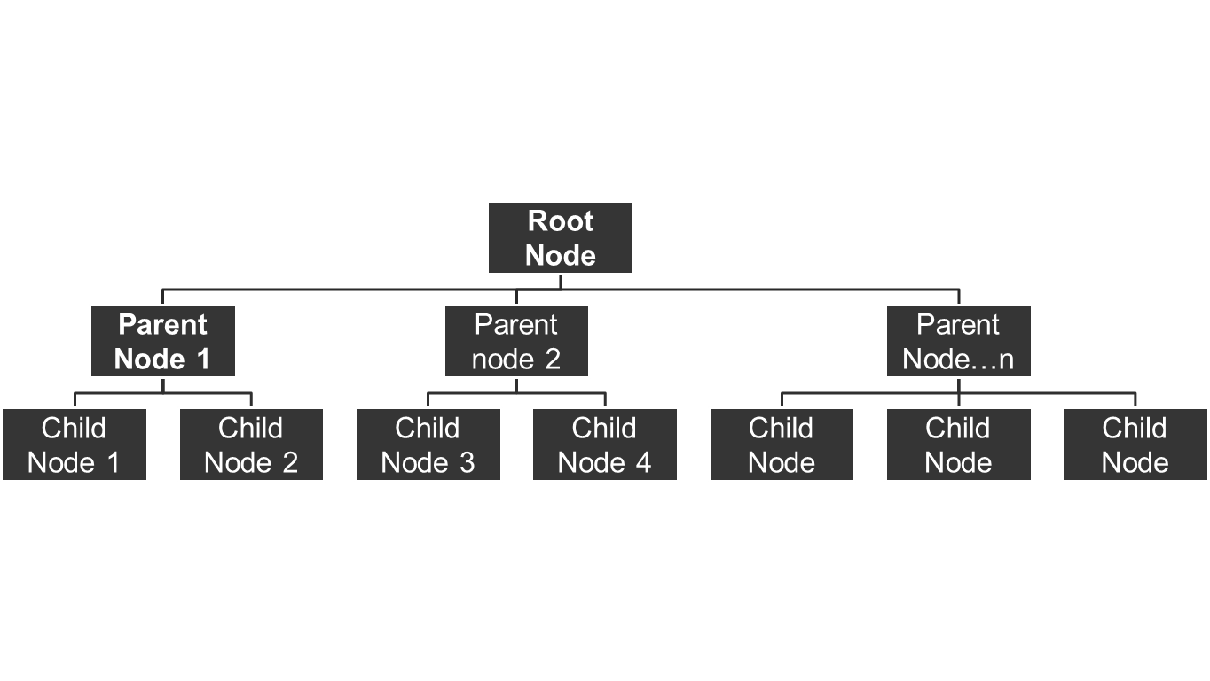
Hierarchical Structure
………

Slide 47


Hierarchical Database
Customers
Customer
Order
Items Ordered
Orders
To retrieve data, you must start at the top (customer). When you retrieve a customer, you retrieve all nested data.
Items
Item Description Quantity
998 Dog Food 12
764 Cat Food 11

Slide 48
Network structure
Customer
Order
101 | Raj | Pune
23334 11/02/07
102 | Avi | Delhi
24556 22/03/07
34445 26/03/07
Owner node
Member node

Slide 49
Network Database
Entry point
Customer
Order
Items
Ordered
Items
Entry point

Slide 50
Relational Structure/ Table structure
Rows
Columns

Slide 51
Relational Database
Customer(CustomerID, Name, …
Order(OrderID, CustomerID, OrderDate, …
ItemsOrdered(OrderID, ItemID, Quantity, …
Items(ItemID, Description, Price, …

Slide 52

A Sample Relational Database

Slide 53
Relational database: A collection of tables.
Table: A collection of columns (attributes) describing an entity. Individual objects are stored as rows of data in the table.
Property (attribute): a characteristic or descriptor of a class or entity.
Every table has a primary key.
  The smallest set of columns that uniquely identifies any row
  Primary keys can span more than one column (concatenated keys)
  We often create a primary key to insure uniqueness (e.g., CustomerID, Product#, . . .) called a surrogate key.
Primary key
Properties
Class: Employee
Rows/Objects
Employee
EmployeeID TaxpayerID LastName FirstName HomePhone Address
12512 888-22-5552 Cartom Abdul (603) 323-9893 252 South Street
15293 222-55-3737 Venetiaan Roland (804) 888-6667 937 Paramaribo Lane
22343 293-87-4343 Johnson John (703) 222-9384 234 Main Street
29387 837-36-2933 Stenheim Susan (410) 330-9837 8934 W. Maple

Slide 54
Object-Oriented Model
Object DBMS add database functionality to object programming languages.
Object DBMS extend the semantics of C++, Smalltalk and Java object programming languages to provide full-featured database programming capability, while retaining native language compatibility.
A major benefit of this approach is the unification of the application and database development into a seamless data model and language environment.
As a result, applications require less code, use more natural data modeling, and code bases are easier to maintain. Object developers can write complete database applications with a modest amount of additional effort.

Slide 55
Object-Oriented DBMS
Order
Customer
OrderID
CustomerID
…
CustomerID
Name
…
Government
Customer
Commercial
Customer
ContactName
ContactPhone
Discount, …
NewOrder
DeleteOrder
…
Add Customer
Drop Customer
Change Address
ContactName
ContactPhone
…
NewContact
NewContact
OrderItem
Item
OrderID
ItemID
…
ItemID
Description
…
OrderItem
DropOrderItem
…
New Item
Sell Item
Buy Item …

Slide 56
ERD
Entity Relationship Diagram
Entity
Attribute
Relationship
Repetitive entity
Weak Entity

Slide 57

Entity-Relationship Model
Example of schema in the entity-relationship model

Slide 58
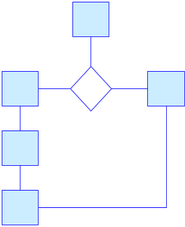
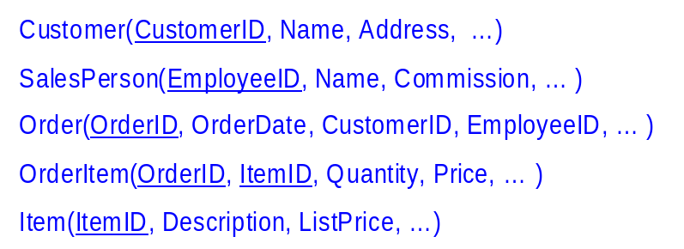


Database System Design
User views
of data.
Conceptual
data model.
Implementation
(relational)
data model.
Physical
data
storage.
Class diagram that shows business entities, relationships, and rules.
List of nicely-behaved tables. Use data normalization to derive the list.
Indexes and storage methods to improve performance.

Slide 59
Purpose of ER Model
To express the logical properties of the database in an enterprise schema
ER diagram are used to express logical structure of the model
ER model is used mainly as a design tool and documentation for the system
It describes the environment in terms of entities
Notes:
Rachana Shikhare

Slide 60
Entity Relationship
Entity Set
An entity set is a set of entities of the same type that share the same properties or attributes
Attributes
Attributes are descriptive properties possessed by each member of an entity set
Notes:
Rachana Shikhare

Slide 61
Entity Relationship …(contd.)
Attribute types:
  Simple & Composite
    Eg Simple: Empno Composite : Ename – fname,mname,lname
  Single-valued & Multi-valued
    E.g Single: Studno Multi-Valued : Phone no
  Derived
    E.g Age: Age could be derived from date of Birth
Notes:
Rachana Shikhare

Slide 62
Entity Relationship …(contd.)
Relationship
A relationship is an association among several entities
Relationship Sets
A relationship set is a set of relationships of a given type
Notes:
Rachana Shikhare
Examples:
Student registered in courses
Passengers booked on flights
Parents and their children
Bank branches, customers and their account

Slide 63
Mapping Cardinalities
Mapping Cardinalities express the number of entities to which another entity can be associated via a relationship set
Following are the possible mapping cardinalities:
  One-to-One
    Student-Pen
  One-to-Many
    Class-Student
  Many-to-One
    Emp-Dept
  Many-to-Many
    Emp-Project
Notes:
Rachana Shikhare

Slide 64
Mapping Cardinalities
1 : 1
1 : M
M : 1
M : M

Slide 65
Existence Dependencies
If the existence of entity x depends on the existence of entity y, x is said to be existence dependent on y.
Entity y is said to be a Dominant entity and x is said to be a subordinate entity
Notes:
Rachana Shikhare

Slide 66
Participation of an entity set in a relation
Total: The participation of an entity set E in a relationship set R is said to be total if every entity in E participates in at least one relationship R
Partial: Part of the set of entities participate in some relationship
Notes:
Rachana Shikhare

Slide 67
Keys
Super Key
Candidate Key
Primary Key
Alternate Key
Foreign Key
Notes:
Rachana Shikhare
Primary Key :
To identify each tuple uniquely we use an attribute of the relation to uniquely identify each row in the table. This attribute is called Primary Key of the relation
Composite Key :
The primary key consists of 1 attribute ,but in certain instances no single attribute of a relation might contain unique values.In such case more than 1 attribute can be used to uniquely identify each row.Such keys are called composite keys.
Candidate keys :
In certain cases there might be more than one attribute that can uniquely identify each row in a relation ,All such keys are called candidate keys since any one of them can be selected as the primary key.
The primary key is also a candidate key.
Foreign Key :
If a relation does not have any candidate key it cannot have a primary key & hence such a table cannot be stored in relational database.
All the attributes in a relation that are not candidate keys are called nonkeys.
This non key attribute might be a primary key of some other table .Such a non key attribute is called foreign key.
Super Key : When one key is not strong enough to become the primary key, then two or more keys are combined to create a primary key . This combined primary key is called as Super Key.

Slide 68
ER Diagram
Overall logical structure of a database can be expressed graphically by an ER diagram
  Rectangles: entity sets
  Ellipses: attributes
  Diamonds: relationship sets
  Double Lines: total participation
  Dashed Ellipse: derived attribute
  Double Ellipse: multivalued attributes
  Lines: link attribute to entity sets and entity sets to relationship set
  Double Rectangle: weak entity
  Attribute with an underline: primary key
Notes:
Rachana Shikhare

Slide 69
ER Diagram …(contd.)
amount
Soc SNo
loan-no
Cust-name
cust-city
borrower
Customer
loan
Notes:
Rachana Shikhare
There are two entity sets Customer and Loan. They are having a relationship between them as borrower. Customer is having attributes like Cust_name,cust_city and social security number(SSN). Primary key is Soc S N. Loan entity set is having attributes like loan-no and amount. Loan-amount is a primary key.

Slide 70
Relational Database ER
Identifying Entities
  Given a system description you can identify entities by:
    Read the given data carefully
    Select all nouns
    Eliminate one’s not necessary
    Ask yourself whether you really need to store / record information of the noun object & how many record could be filled for the same.
    Recommended to label the entities in Uppercase & Singular .
Notes:
Rachana Shikhare

Slide 71
Relational Database ER…(contd.)
Entities are classified as:
  DOMINANT ENTITIES: An entity that does not depend on another entity for its existence is a dominant or strong entity
  WEAK ENTITIES: An entity that depends on some other entity for its existence
Notes:
Rachana Shikhare
DOMINANT ENTITIES : An entity that does not depend on another entity for its existence is a dominant or strong entity.
WEAK ENTITIES : An entity that depends on some other entity for its existence

Slide 72
Relational Database ER…(contd.)
Entities are classified as:
  DOMINANT ENTITIES: An entity that does not depend on another entity for its existence is a dominant or strong entity
  WEAK ENTITIES: An entity that depends on some other entity for its existence
Notes:
Rachana Shikhare
DOMINANT ENTITIES : An entity that does not depend on another entity for its existence is a dominant or strong entity.
WEAK ENTITIES : An entity that depends on some other entity for its existence

Slide 73
Relational Database ER…(contd.)
If the weak entity does not have a primary key of its own then you can use a combination of the primary key of the dominant entity & an attribute of the weak entity as the primary key of the weak entity
  WEAK ENTITY:
    For example: KEY_PERSON_NAME cannot uniquely identify a key person. Hence SUPP_CODE & KEY_PERSON_NAME can be used as a key.
Notes:
Rachana Shikhare
WEAK ENTITY :
For eg : KEY_PERSON_NAME cannot uniquely identify a key person Hence SUPP_CODE & KEY_PERSON_NAME can be used as a key.

Slide 74
Relational Database ER …(contd.)
Entities are linked to each other through relationships. Hence a relationship is an association between 2 entities.
eg:
  Entity Relationship Entity
  Supplier supplies Items
Notes:
Rachana Shikhare

Slide 75
Relational Database ER
1-1
  Supplier------Key Person
1-M
  Dept-----Emp
M-1
  Emp-----Dept
M:M
  Student----Subjects
Notes:
Rachana Shikhare

Slide 76
ER Example
fname
mname
lname
detno
dname
loc
empno
ename
sal
N
Belongs to
1
DEPT
EMP
1
No of hrs
1
M
has
Assigned to
Manages
N
N
1
DEPENDENTS
PROJECT
Dep_name
relation
proj_id
projname
Notes:
Rachana Shikhare

Slide 77
Relational Database ER…(contd.)
Once the entities & relationship between the entities is identified you can represent them in a ER dagam
Notes:
Rachana Shikhare

Slide 78
Entity Relationship Model

Slide 79
ERD
It describes the data involved in a real world enterprise in terms of objects and their relationship
It illustrate the logical structure of databases .
It is used in a phase called conceptual database design
ER model is used mainly as a design tool and documentation for the system
Peter Chen developed ERDs in 1976.

Slide 80
Entity, Entity Set
Attributes
An entity is an object or concept about which you want to store information.
An entity may be an object with a physical existence (person, car) or with a conceptual existence(company,university)
Notes:
Entities :
To interpret the relational database you perceive the real world as a set of objects and relationships between these objects. These basic objects are called entities

Slide 81
Entity Set
An entity set is a set of entities of the same type that share the same properties or attributes
Attributes -
Attributes are descriptive properties possessed by each member of an entity set

Slide 82
Attribute types
  Simple & Composite
  Single-valued & Multi-valued
  Derived - E.g Age: Age could be derived from date of Birth
F_Name
Emp-Name
Emp-Name
M_Name
L_Name
Stud_Name
Contact_Number
Age
Notes:
Key attribute
A key attribute is the unique, distinguishing characteristic of the entity. For example, an employee's social security number might be the employee's key attribute.
Multivalued attribute
A multivalued attribute can have more than one value. For example, an employee entity can have multiple skill values.
Derived attribute
A derived attribute is based on another attribute. For example, an employee's monthly salary is based on the employee's annual salary.
Key attribute
A key attribute is the unique, distinguishing characteristic of the entity. For example, an employee's social security number might be the employee's key attribute.
Multivalued attribute
A multivalued attribute can have more than one value. For example, an employee entity can have multiple skill values.
Derived attribute
A derived attribute is based on another attribute. For example, an employee's monthly salary is based on the employee's annual salary.

Slide 83
Relationship And Relationship Set
Relationship
A relationship is an association among several entities
A relationship can also have attributes
Relationship Sets
A relationship set is a set of relationships of a given type
Notes:
Examples:
Student registered in courses
Passengers booked on flights
Parents and their children
Bank branches, customers and their account

Slide 84
NOTATION FOR ER SCHEMAS
Symbol
Meaning
ENTITY TYPE
WEAK ENTITY TYPE
RELATIONSHIP TYPE
IDENTIFYING RELATIONSHIP TYPE
ATTRIBUTE
KEY ATTRIBUTE
MULTIVALUED ATTRIBUTE
COMPOSITE ATTRIBUTE
DERIVED ATTRIBUTE
TOTAL PARTICIPATION OF E₂ IN R
CARDINALITY RATIO 1:N FOR E₁:E₂ IN R
STRUCTURAL CONSTRAINT (min, max) ON PARTICIPATION OF E IN R
E₁
R
E₂
E₁
R
N
E₂
R
(min,max)
E

Slide 85
ER Diagram
amount
Soc SNo
loan-no
Cust-name
cust-city
borrower
CUSTOMER
LOAN
Notes:
There are two entity sets Customer and Loan. They are having a relationship between them as borrower. Customer is having attributes like Cust_name,cust_city and social security number(SSN). Primary key is Soc S N. Loan entity set is having attributes like loan-no and amount. Loan-amount is a primary key.

Slide 86
ERD
Identifying Entities
Given a system description you can identify entities by:
    Select all nouns
    Eliminate one’s not necessary
    Filter those for which system needs to stores record.
    Identify the attributes that describes the entity

Slide 87
Entity
Entities are classified as:
  DOMINANT ENTITIES: An entity that does not depend on another entity for its existence is a dominant or strong entity
  WEAK ENTITIES: An entity that depends on some other entity for its existence
Notes:
DOMINANT ENTITIES : An entity that does not depend on another entity for its existence is a dominant or strong entity.
WEAK ENTITIES : An entity that depends on some other entity for its existence

Slide 88
Existence Dependencies
If the existence of entity x depends on the existence of entity y, x is said to be existence dependent on y.
Entity y is said to be a Dominant entity and x is said to be a subordinate entity

Slide 89
Weak Entity
A weak entity does not have a primary key of its own
You can use a combination of the primary key of the dominant entity & an attribute of the weak entity as the primary key of the weak entity.
Thus a discriminator of Weak Entity + Prime attribute of the its Dominant Entity.
Emp_id
EMPLOYEE
Emp_id+Nom_id+Relation
Has
NOMINEE
Notes:
WEAK ENTITY :
For eg : KEY_PERSON_NAME cannot uniquely identify a key person Hence SUPP_CODE & KEY_PERSON_NAME can be used as a key.

Slide 90
Entities are linked to each other through relationships. Hence a relationship is an association between 2 entities.
eg:
Entity Relationship Entity
  SUPPLIER supplies ITEM

Slide 91
Participation of an entity set in a relation
Total: The participation of an entity set E in a relationship set R is said to be total if every entity in E participates in at least one relationship R
Partial: Part of the set of entities participate in some relationship

Slide 92
Total & Partial Participation
amount
Soc SNo
loan-no
Cust-name
cust-city
borrower
CUSTOMER
LOAN
Notes:
Customer may or may not apply for a loan . But there will exist no loan without a customer. Hence participation of loan is total.

Slide 93
Degree of Relationship
Unary : Degree 1
Binary : Degree 2
Ternary : Degree 3
N-ary : Degree n
EMPLOYEE
manages
Soc SNo
loan-no
amount
Cust-name
cust-city
borrower
LOAN
CUSTOMER
ORDER
Has
ITEM
Order_dtls

Slide 94
Cardinality Ratio/
Mapping Cardinality
Mapping Cardinality express the number of entities to which another entity can be associated via a relationship set

Slide 95
Relational Database ER
1-1
  Supplier------Key Person
1-M
  Dept-----Emp
M-1
  Emp-----Dept
M:M
  Student----Subject

Slide 96
ERD
Once the entities & relationship between the entities is identified you can represent them in a ER diagram

Slide 97
ER Example
fname
mname
lname
detno
dname
loc
empno
ename
sal
N
Belongs to
1
DEPT
EMP
1
No of hrs
1
M
has
Assigned to
Manages
N
N
1
DEPENDENTS
PROJECT
Dep_name
relation
proj_id
projname

Slide 98
ER …(contd.)
This schema has 3 entity types
  EMPLOYEE
  DEPT
  PROJECT
& one weak entity type DEPENDENT
There is M:N relationship between PROJECT and EMP
entity sets
There is a 1:1 relationship between DEPT and PROJECT
There is a 1:M relationship between DEPT and EMP
entity sets
No of hrs is an attribute on the relation “assigned to” between EMP and PROJECT

Slide 99
Enhanced features of ER Model

Slide 100
Enhanced-ER (EER) Model Concepts
Includes all modeling concepts of basic ER
Additional concepts: subclasses / superclasses, specialization/generalization, categories, attribute inheritance
The resulting model is called the enhanced-ER or Extended ER (E2R or EER) model
It is used to model applications more completely and accurately if needed
It includes some object-oriented concepts, such as inheritance

Slide 101
Subclasses and Superclasses
An entity type may have additional meaningful sub groupings of its entities
Example: EMPLOYEE may be further grouped into SECRETARY, ENGINEER, MANAGER, TECHNICIAN, SALARIED_EMPLOYEE, HOURLY_EMPLOYEE,…
  Each of these groupings is a subset of EMPLOYEE entities
  Each is called a subclass of EMPLOYEE
  EMPLOYEE is the superclass for each of these subclasses
These are called superclass/subclass relationships.
Example: EMPLOYEE/SECRETARY, EMPLOYEE/TECHNICIAN
These are also called IS-A relationships (SECRETARY IS-A EMPLOYEE, TECHNICIAN IS-A EMPLOYEE, …).

Slide 102
Attribute Inheritance in Superclass / Subclass Relationships
An entity that is member of a subclass inherits all attributes of the entity as a member of the superclass
It also inherits all relationships

Slide 103
Specialization
Is the process of defining a set of subclasses of a superclass
The set of subclasses is based upon some distinguishing characteristics of the entities in the superclass
Example: {SECRETARY, ENGINEER, TECHNICIAN} is a specialization of EMPLOYEE based upon job type.
  May have several specializations of the same superclass
Example: Another specialization of EMPLOYEE based in method of pay is {SALARIED_EMPLOYEE, HOURLY_EMPLOYEE}.
  Superclass/subclass relationships and specialization can be diagrammatically represented in EER diagrams
  Attributes of a subclass are called specific attributes. For example, TypingSpeed of SECRETARY
  The subclass can participate in specific relationship types. For example, BELONGS_TO of HOURLY_EMPLOYEE

Slide 104
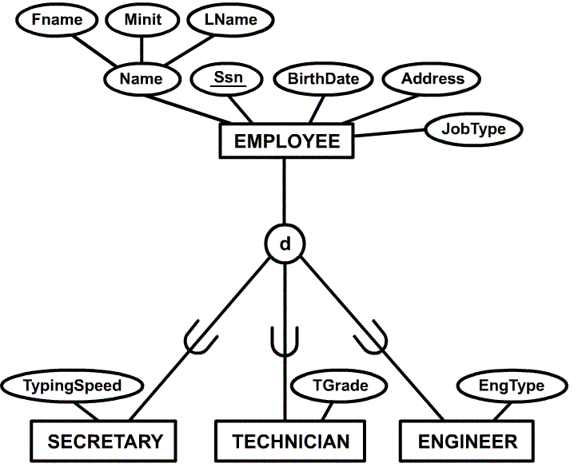
Example of a Specialization

Slide 105
Generalization
The reverse of the specialization process
Several classes with common features are generalized into a superclass; original classes become its subclasses
Example: CAR, TRUCK generalized into VEHICLE; both CAR, TRUCK become subclasses of the superclass VEHICLE.
  We can view {CAR, TRUCK} as a specialization of VEHICLE
  Alternatively, we can view VEHICLE as a generalization of CAR and TRUCK

Slide 106
Constraints on Specialization and Generalization
If we can determine exactly those entities that will become members of each subclass by a condition, the subclasses are called predicate-defined (or condition-defined) subclasses
  Condition is a constraint that determines subclass members
  Display a predicate-defined subclass by writing the predicate condition next to the line attaching the subclass to its superclass
If all subclasses in a specialization have membership condition on same attribute of the superclass, specialization is called an attribute defined-specialization
  Attribute is called the defining attribute of the specialization
  Example: JobType is the defining attribute of the specialization {SECRETARY, TECHNICIAN, ENGINEER} of EMPLOYEE
If no condition determines membership, the subclass is called user-defined
  Membership in a subclass is determined by the database users by applying an operation to add an entity to the subclass
  Membership in the subclass is specified individually for each entity in the superclass by the user

Slide 107
Constraints on Specialization and Generalization
Two other conditions apply to a specialization/generalization:
Disjointness Constraint:
  Specifies that the subclasses of the specialization must be disjointed (an entity can be a member of at most one of the subclasses of the specialization)
  Specified by d in EER diagram
  If not disjointed, overlap; that is the same entity may be a member of more than one subclass of the specialization
  Specified by o in EER diagram
Completeness Constraint:
  Total specifies that every entity in the superclass must be a member of some subclass in the specialization/ generalization
  Shown in EER diagrams by a double line
  Partial allows an entity not to belong to any of the subclasses
  Shown in EER diagrams by a single line

Slide 108
Constraints on Specialization and Generalization
Hence, we have four types of specialization/generalization:
  Disjoint, total
  Disjoint, partial
  Overlapping, total
  Overlapping, partial
Note: Generalization usually is total because the superclass is derived from the subclasses.

Slide 109
Example of disjoint partial Specialization

Slide 110
Categories (UNION TYPES)
All of the superclass/subclass relationships we have seen thus far have a single superclass
A shared subclass is subclass in more than one distinct superclass/subclass relationships, where each relationships has a single superclass (multiple inheritance)
In some cases, need to model a single superclass/subclass relationship with more than one superclass
Superclasses represent different entity types
Such a subclass is called a category or UNION TYPE
Example: Database for vehicle registration, vehicle owner can be a person, a bank (holding a lien on a vehicle) or a company.
  Category (subclass) OWNER is a subset of the union of the three superclasses COMPANY, BANK, and PERSON
  A category member must exist in at least one of its superclasses

Slide 111
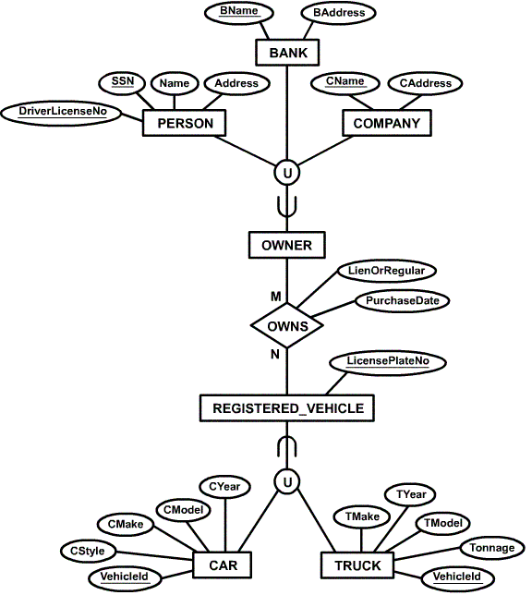
Example of categories
(UNION TYPES)

Slide 112
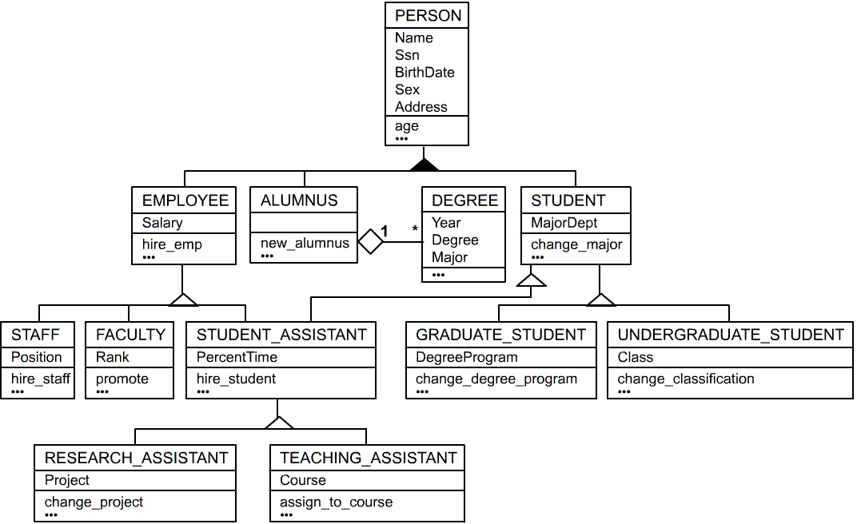
UML Example for Displaying Specialization / Generalization

Slide 113
ER to Relational Mapping
Step 1:
For regular entity E, create relation R including simple attributes and simple component of a composite attribute
Choose one of the key attribute as a primary key for all strong entities

Slide 114
ER to Relational Mapping…(contd.)
Step 1:
EMP
p . k
empno
fname
mname
lname
sal
DEPT
p. k
deptno
dname
loc
PROJECT
p . k
Proj_id
projname
DEPENDENT
Super key
empno
Dep_name
relation

Slide 115
ER to Relational Mapping…(contd.)
Step 2:
  For each weak entity type W in the ER schema with owner entity type E,we create a relation R and include all simple attributes of W as attributes of R
  In addition, we include as foreign key attributes of R, the primary key attributes of the relation that corresponds to the owner entity type E.
  The primary key of R is the combination of the primary key of the owner & the partial key of the weak entity type W
Notes:
For each weak entity type W in the ER schema with owner entity type E,we create a relation R and include all simple attributes of W as attributes of R . In addition , we include as foreign key attributes of R ,the primary key attributes of the relation that corresponds to the owner entity type E. The primary key of R is the combination of the primary key of the owner & the partial key of the weak entity type W

Slide 116
ER to Relational Mapping…(contd.)
Step 2:
EMP
P .k
f. k
empno
fname
mname
lname
sal
deptno
P .k
DEPT
f. k
deptno
dname
loc
P .k
PROJECT
Proj_id
Proj_name
deptno
DEPENDENT
Super key
empno
Dep_name
relation
Notes:
For each binary M:N relationship type R, we create a new relation S to represent R. We include as foreign key attributes in S the primary keys of the relations that represent the participating entity types ; their combination will form the primary key of S. We also include any simple attributes of the M:N relationship type as attributes of S.

Slide 117
ER to Relational Mapping…(contd.)
Step 3:
  For each binary 1:1 relationship type R, we identify the relations S and T that correspond to the entity types participating in R
  We choose one of the relations S ,say & include as a foreign key in S the primary key of T. Choose an entity type with total participation in R in the role of S.
  We include all the simple attributes of the 1:1 relationship R as attributes of S
Notes:
For each binary 1:1 relationship type R we identify the relations S and T that correspond to the entity types participating in R . We choose one of the relations S ,say & include as a foreign key in S the primary key of T. Choose an entity type with total participation in R in the role of S. We include all the simple attributes of the 1:1 relationship R as attributes of S.

Slide 118
ER to Relational Mapping…(contd.)
Step 3:
EMP
P . k
f. k
empno
fname
mname
lname
sal
deptno
DEPT
P .k
deptno
dname
loc
P .k
PROJECT
f. k
Proj_id
Proj_name
deptno
DEPENDENT
Super key
empno
Dep_name
relation

Slide 119
ER to Relational Mapping…(contd.)
Step 4:
  For each regular (nonweak) binary 1:N relationship type R, we identify the relation S that represents the participating entity type at the N-side of the relationship type.
  We include as foreign key in S the primary key of relation T that represents the other entity type participating in R; this is because each entity instance on the N-side is related to at most one entity instance on 1 side of relationship type.
Notes:
For each regular (nonweak) binary 1:N relationship type R, we identify the relation S that represents the participating entity type at the N-side of the relationship type . We include as foreign key in S the primary key of relation T that represents the other entity type participating in R ; this is because each entity instance on the N-side is related to at most one entity instance on 1 side of relationship type.

Slide 120
ER to Relational Mapping…(contd.)
Step 4:
EMP
P .k
F .k
empno
fname
mname
lname
sal
deptno
P .k
DEPT
deptno
dname
loc
P .k
PROJECT
f. k
Proj_id
Proj_name
deptno
Super key
DEPENDENT
empno
Dep_name
relation

Slide 121
ER to Relational Mapping…(contd.)
Step 5:
  For each binary M:N relationship type R, we create a new relation S to represent R.
  We include as foreign key attributes in S the primary keys of the relations that represent the participating entity types.
  The combination will form the primary key of S. We also include any simple attributes of the M:N relationship type as attributes of S.

Slide 122
ER to Relational Mapping…(contd.)
Step 5:
EMP
P .k
F .k
empno
fname
mname
lname
sal
deptno
DEPT
P .k
deptno
dname
loc
P .k
PROJECT
f. k
Proj_id
Proj_name
deptno
Super key
EMP_PROJ
Empno
Proj_id
No_of_hrs
Super key
DEPENDENT
empno
Dep_name
relation

Slide 123
Thank You !

